Slide 1
Data From APIs and Feeds
Paritosh Rai

Slide 2
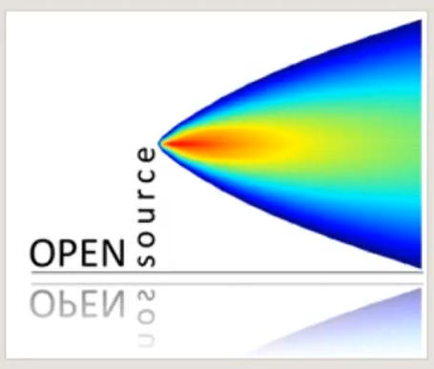
Package ‘openair’ Tools for the Analysis of Air Pollution Data
Description
Tools to analyze, interpret and understand air pollution data.
Data are typically hourly time series
Monitoring data
Dispersion model output can be analyzed.
Many functions can also be applied to other data, including meteorological and trafﬁc data.
Contains data from 1998 to mid of 2005
Table contains ~65K rows and 10 columns
For the main openair website, see http://davidcarslaw.github.io/openair
The OpenAir Manual
http://www.openair-project.org/PDF/OpenAir_Manual.pdf

Slide 3
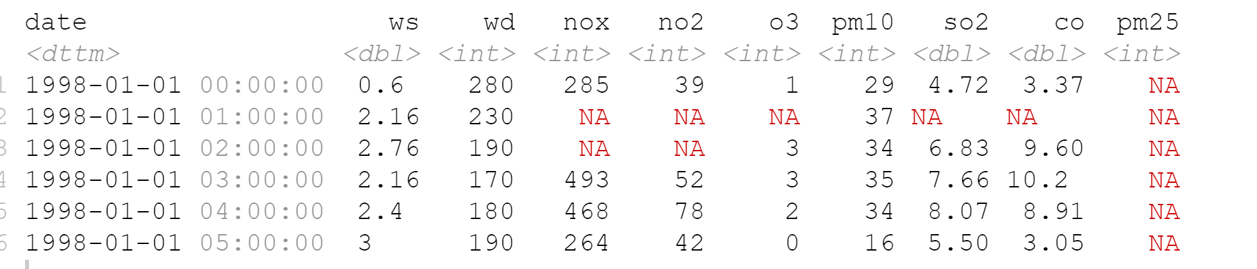
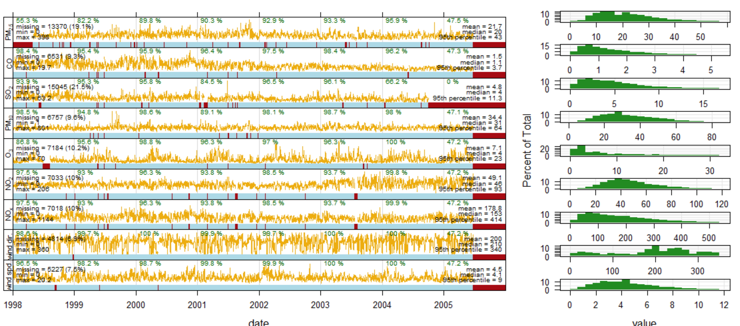
mydata Summary
It contains hourly pollution data .
Data contains lot of N/A so may need clean up before using it.
It contains Wind Speed(ws), Wind direction(wd). Nox,NO2, Ozone(03), pm10,so2,co and pm2.5
Summary data
Gives trend of every pollutant along with ws and wd.
Summary (my data)
Data give the summary function is extremely useful.
It shows that there are 9 variables.
It provides the minimum, maximum, mean, median, and the ﬁrst and third quantiles.
Also shown is something called NA's, which are missing data.

Slide 4
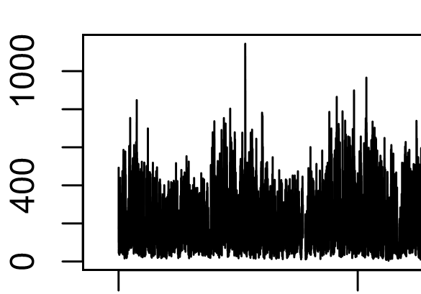
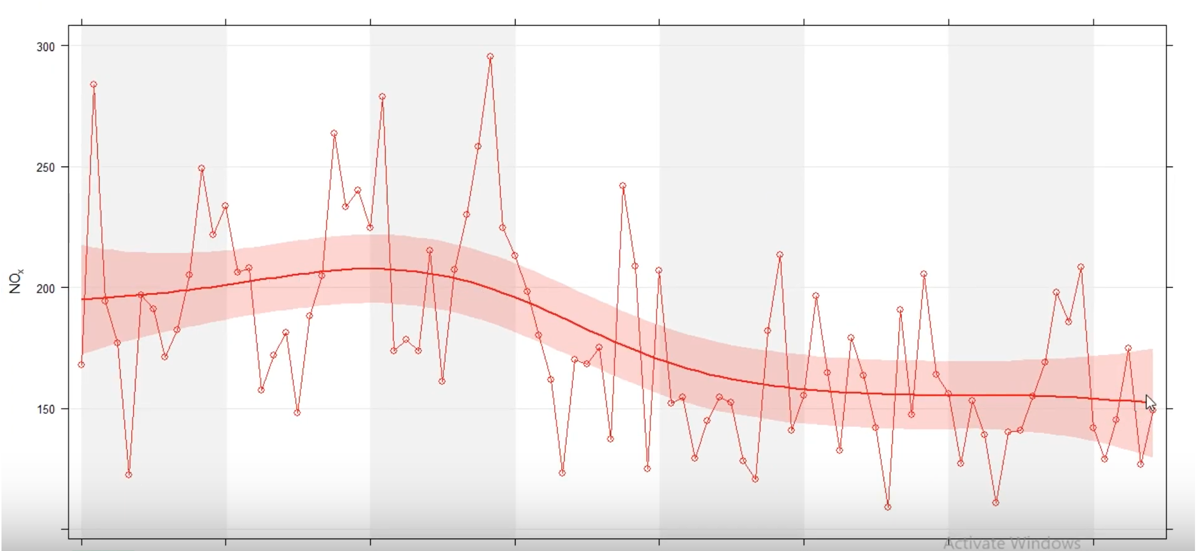
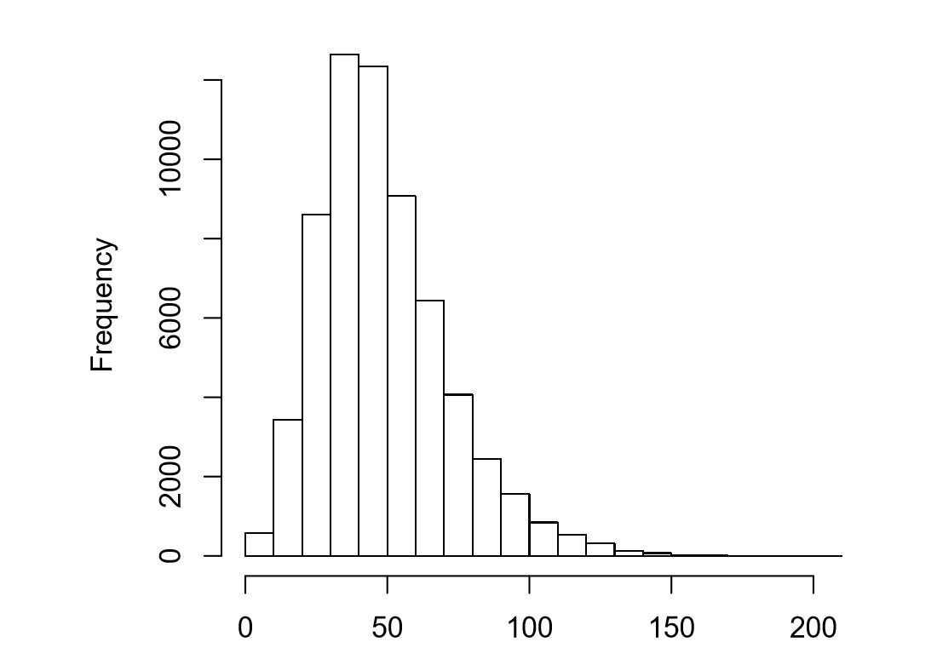
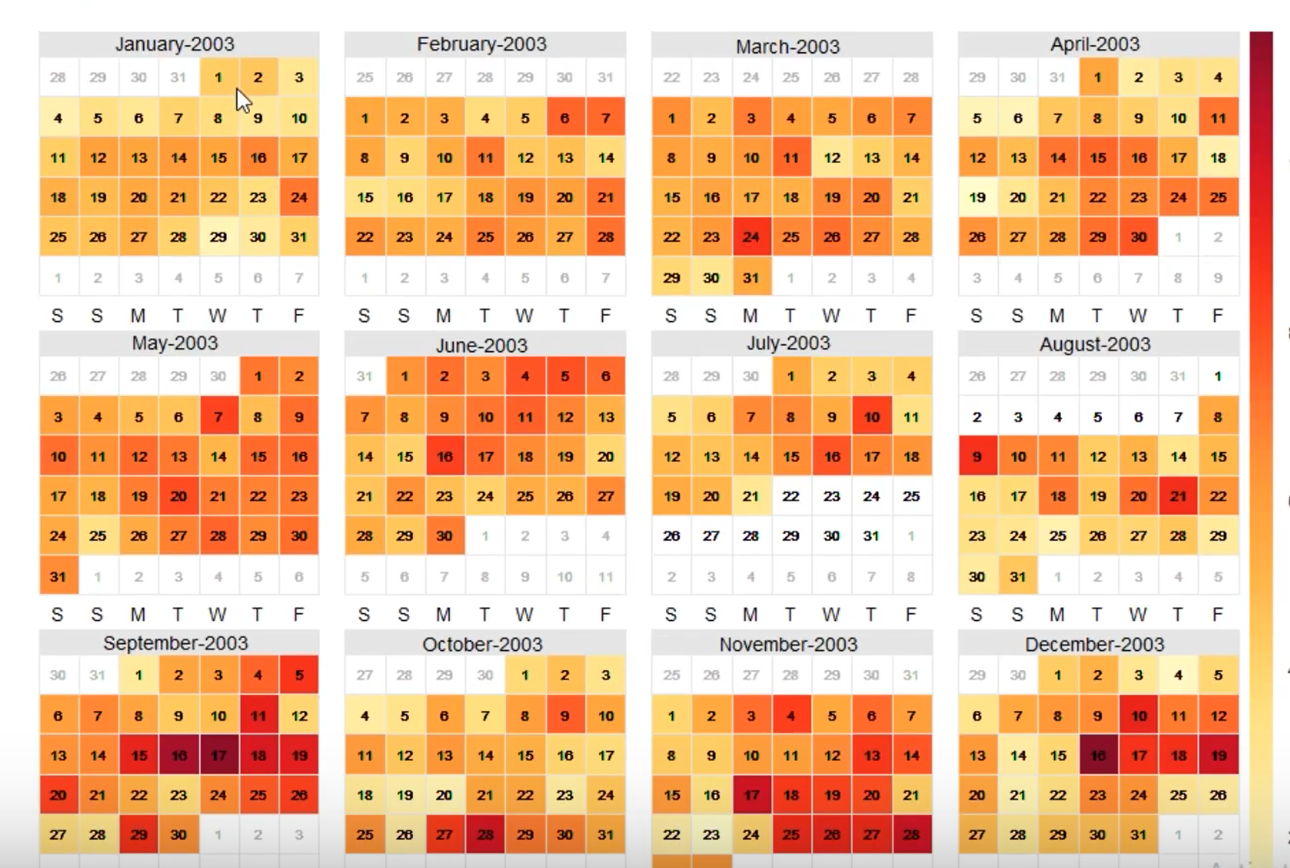
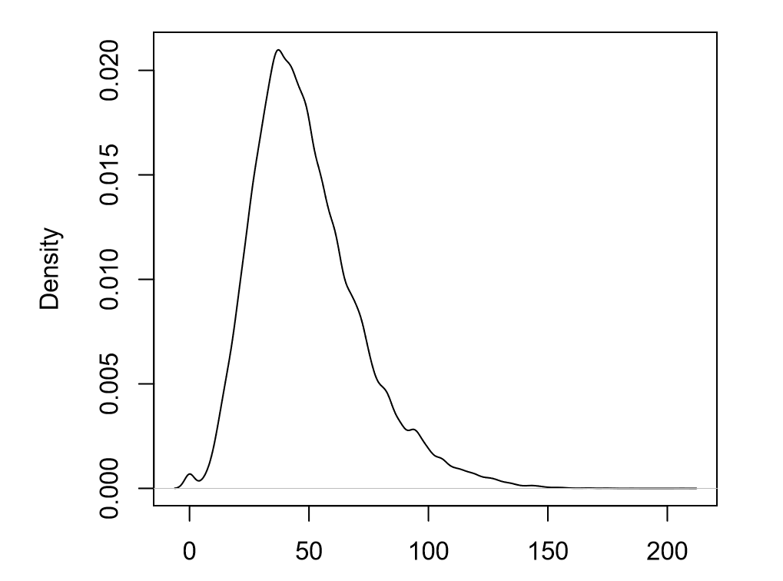
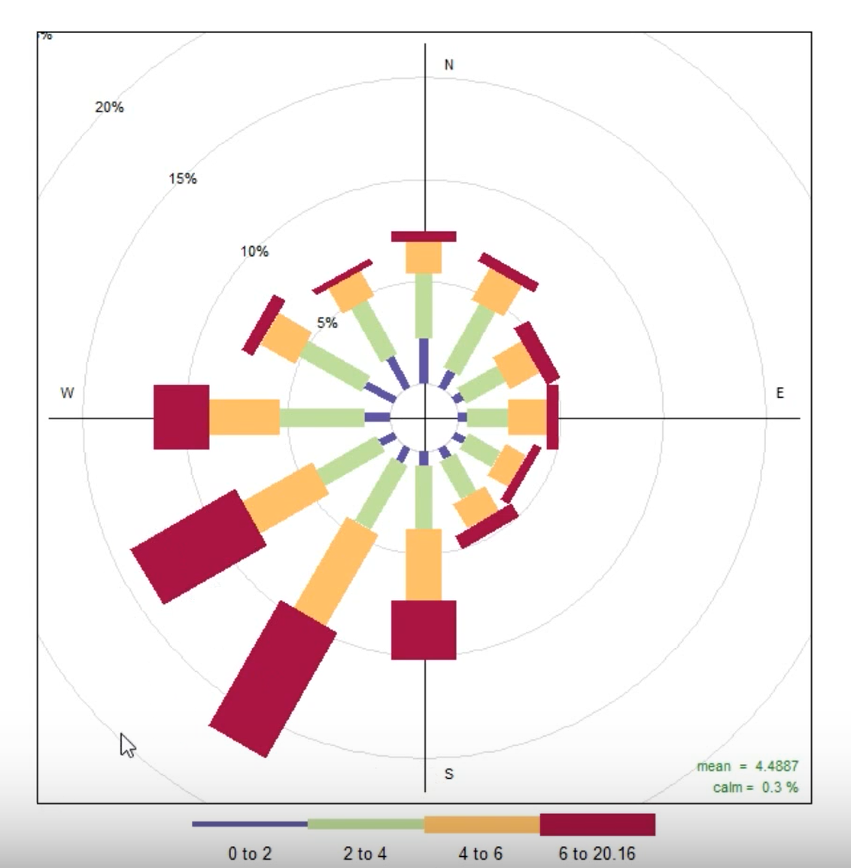
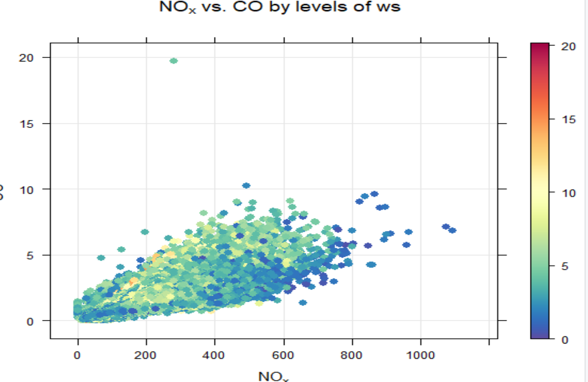
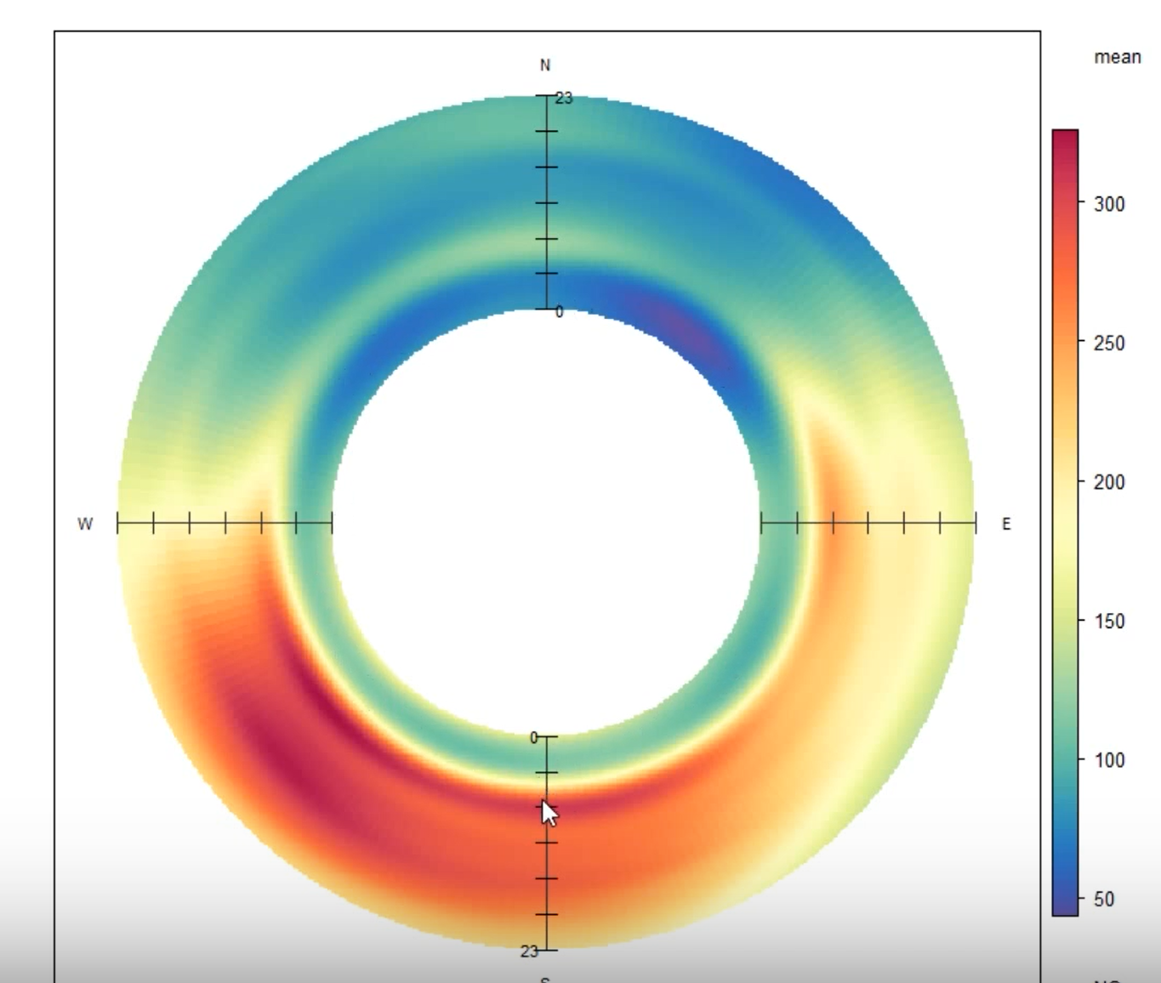
Plotting
Package has very strong plotting capabilities
time series with diﬀerent averaging times
Adding trend lines
Histogram
Calendar Plot
Density Plot (Frequency)
Windrose plot
Scatter plot in three dimensions
Donut Chart

Slide 5
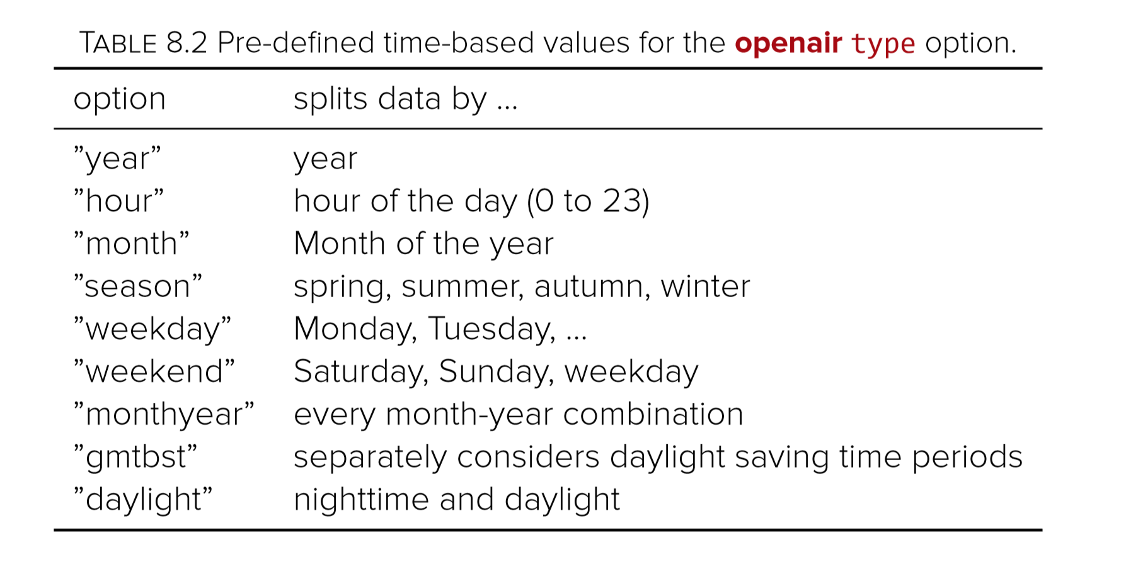
Pre-define Time-Based Values
Very help to analyze and plot hourly, monthl, season ….y

